Slide 1


Advanced Modelling of Point Defect Concentrations Using KROGER & “Birth Announcement” of KROGER
K. Aadi Arnab, Megan Stephens, Isaac Maxfield, and Mike Scarpulla
¹ MSE Department, University of Utah
² ECE Department, University of Utah
Developed under AFOSR MURI award number FA9550-18-1-0507, PM: Dr. Ali Sayir

Slide 2
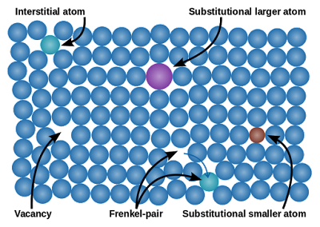
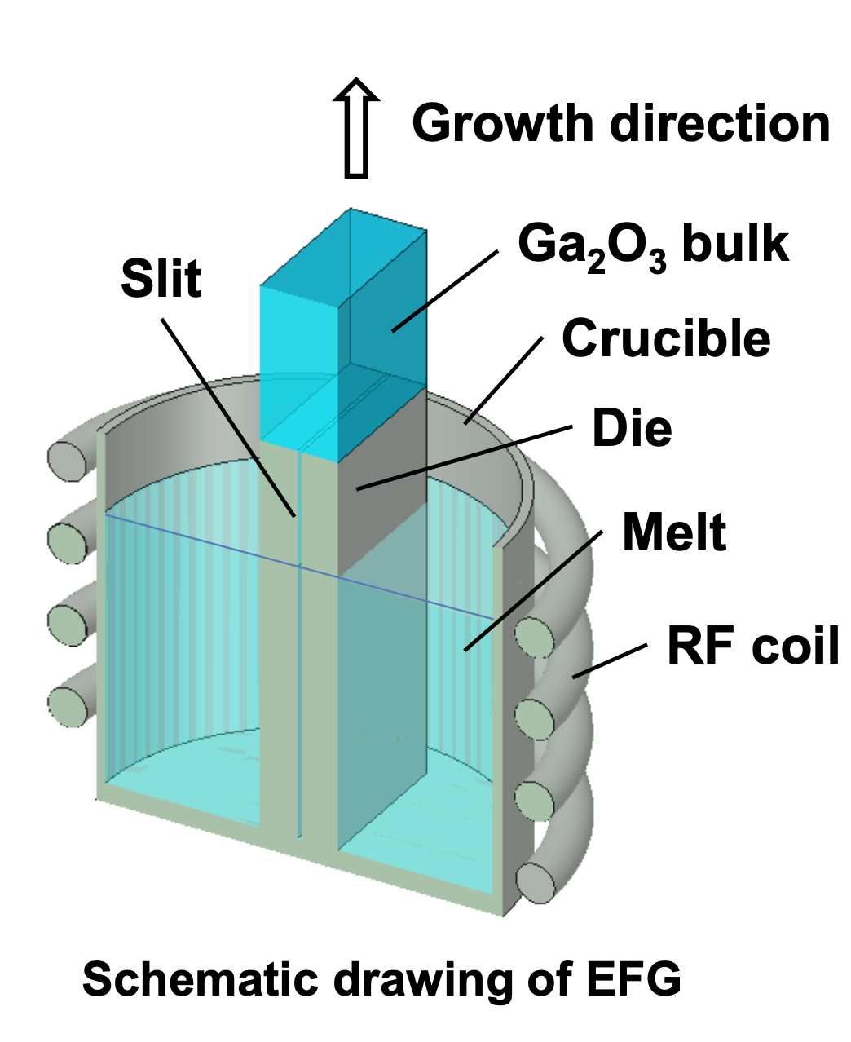
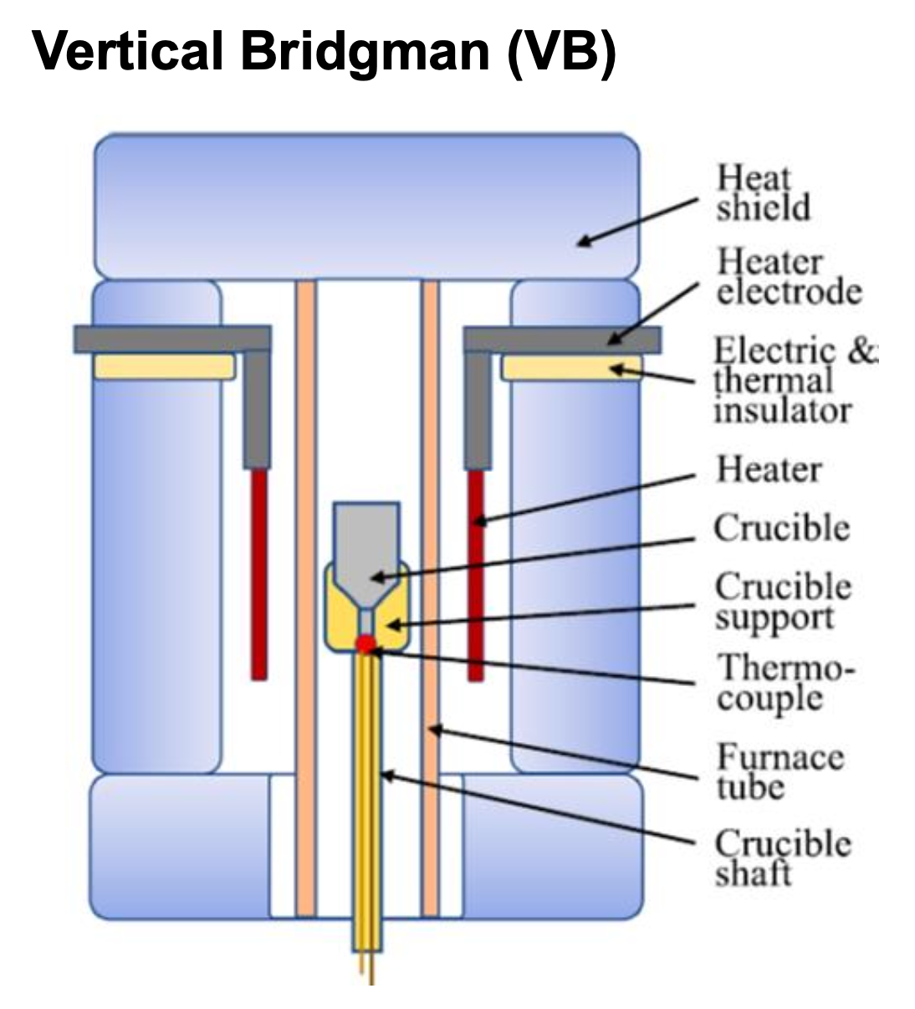
Goal: Quantitative Computation of Point Defects for Specific Semiconductor Samples
DFT with hybrid functionals has shown it can predict atomic configurations, formation energies, charge transition levels, etc for semiconductor defects
But… there are still a lot of steps between those energetics and making quantitative predictions for real-world samples.
Kroger is a step on the path towards that vision
Two different growth methods for β-Ga₂O₃ using different pO₂ and different crucibles that introduce different impurities

Slide 3
What Does KRÖGER Do (as of now)?
KROGER is a Matlab program we developed for advanced calculations of defect concentrations
KROGER calculates the local densities of point defects and complexes in a crystal given their formation energies, T-dependent properties of the material, and mixed sets of constraints on element concentrations or chemical potentials.
KROGER was built to bridge the gap between DFT-based calculations of defect formation energies and real-world samples.
In the real world, a bulk crystal or epitaxial layer of a semiconductor is grown or processed at fixed total pressure, fixed partial pressures of reactive gases like O₂ and may also contain various unintentional impurities.
In many DFT papers, valuable qualitative insights into dominant defects are presented for chemical potentials at the limiting cases of phase stability (e.g. O-rich or Ga-rich for Ga₂O₃). However, the 0 K energetics is not the whole story for all temperatures.
KROGER takes formation energies for defects and complexes, adds to them T-dependent quantities like bandgap and T-dependent chemical potentials from thermochemistry, vibrational entropy, … and computes concentrations for full equilibrium, full quenching, and other scenarios.

Slide 4
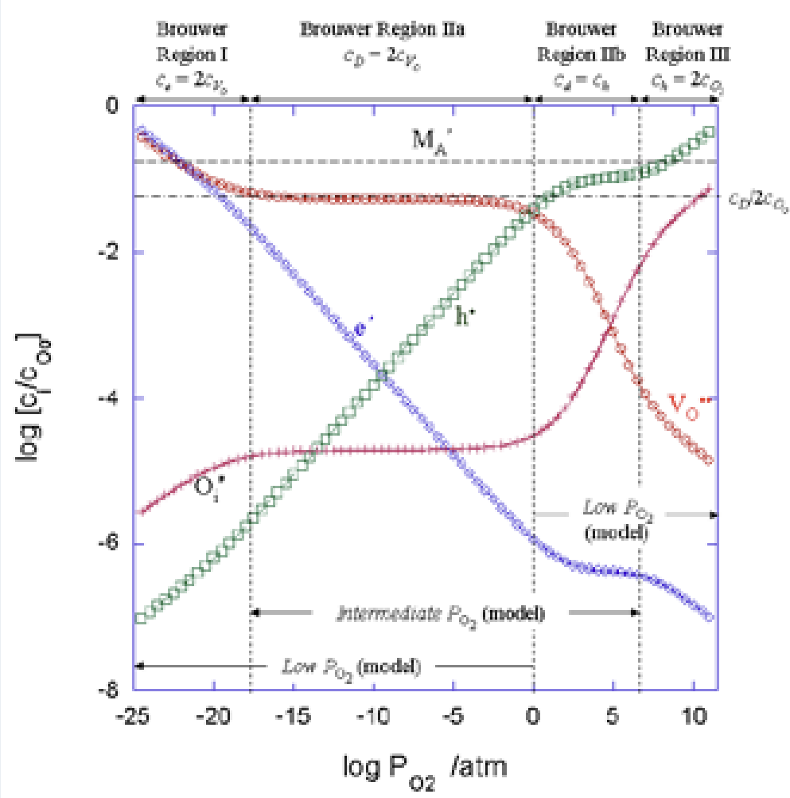
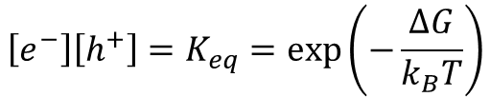

Insulator / Semiconductor Defect Calculations: Historical Approach
Schematic Brouwer diagram for
e⁻/h⁺, M/M⁺, and V_{O}/O_{i} equilibria
Wachsman, https://www.electrochem.org/dl/interface/wtr/wtr07/wtr07_p27-28.pdf
Perfect unit cell$⇌e^{−}+h^{+}$
$$\left[e^{−}\right]\left[h^{+}\right]=K_{eq}=exp⁡\left(−\frac{ΔG}{k_{B}T}\right)$$
Semiconductors and insulators are more difficult than metals because of bandgap and different chargestates for each defect may be possible.
~100 years ago: quasichemical defect formation reactions and equilibrium constants. No great way to calculate absolute numbers, but clever assumptions and analysis of dominant defects predict trends like pO₂ dependencies.
Experiments used to determine equilibrium constants for reactions.
Analysis relies on assuming or testing a model of dominant defects and impurities.

Slide 5
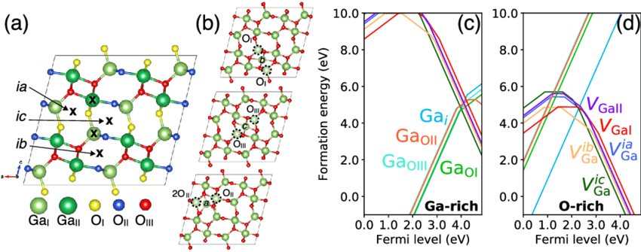
Insulator / Semiconductor Defect Calculations: Density Functional Theory for Energetics
Example of defect formation energy calculations using hybrid functionals
Ingebrigtsen, APL Materials 7(2) 022510 (2019)
In past decade or two, computing power and hybrid functionals using supercells and self-interaction corrections have allowed accurate DFT calculations of bandgaps and defect charge transition levels, which are derived from formation energies of their chargestates.
Translating to quasi-chemical framework: now we can calculate numerical values for defect formation reactions not just how they scale with T, P etc.
DFT is capable of giving absolute formation energies for defect “half-reactions”, e.g. formation energies of vacancies or interstitials alone, rather than for a Frenkel pair.
DFT is not immune to assumptions about dominant defects, but automation of searching through possibilities provides a path for lessening assumption bias.

Slide 6
What Can KROGER Do?
Example (paraphrasing, we’re not at the natural language stage quite yet):
You: “Hey KROGER, read this huge list of 622 chargestates of 193 defects and complexes in β-Ga₂O₃ involving Ga, O, Sn, and 13 other impurity atoms along with the formation energies Joel Varley and Ymir Frodason* calculated using DFT with hybrid functionals. Predict the concentrations of all of them for 1 atm total pressure and pO₂=0.02 atm in equilibrium with a crystal of β-Ga₂O₃ from 500-2100 K in 50 K steps. Hold the total number of Sn impurities summed across 22 of those chargestates constant at 2x10¹⁸ /cm³, but zero out all the other impurities’ concentrations for now. Take into account the T dependence of the bandgap, T-dependence of the standard Gibbs energies of Ga, O₂, and Ga₂O₃ too. Ignore the vibrational entropy for now – let’s look at that later. Enforce site blocking such that multiple defects of any type don’t occupy the same lattice site. When you’re done, show me all of the defects’ concentrations including electrons and holes vs T, a plot of E_{F} and the band edges vs T, and all of the chemical potentials vs T including the one for Sn you had to solve for at each T. Do an exhaustive search in the E_{F}-μ_{Sn} space to eliminate spurious and local minimum solutions. Also, please show what happens if we quench from each of those temperatures to 300 K. Also break it down by chargestate. Show me the total concentrations of all elements summed over all defects vs T. Save the results to an ASCII table so I can plot it in my favorite program for my paper. ”
Kroger: “No problem, I was made for this kind of thing. Give me and Matlab about 5 min on your 5-year-old laptop. ”

Slide 7
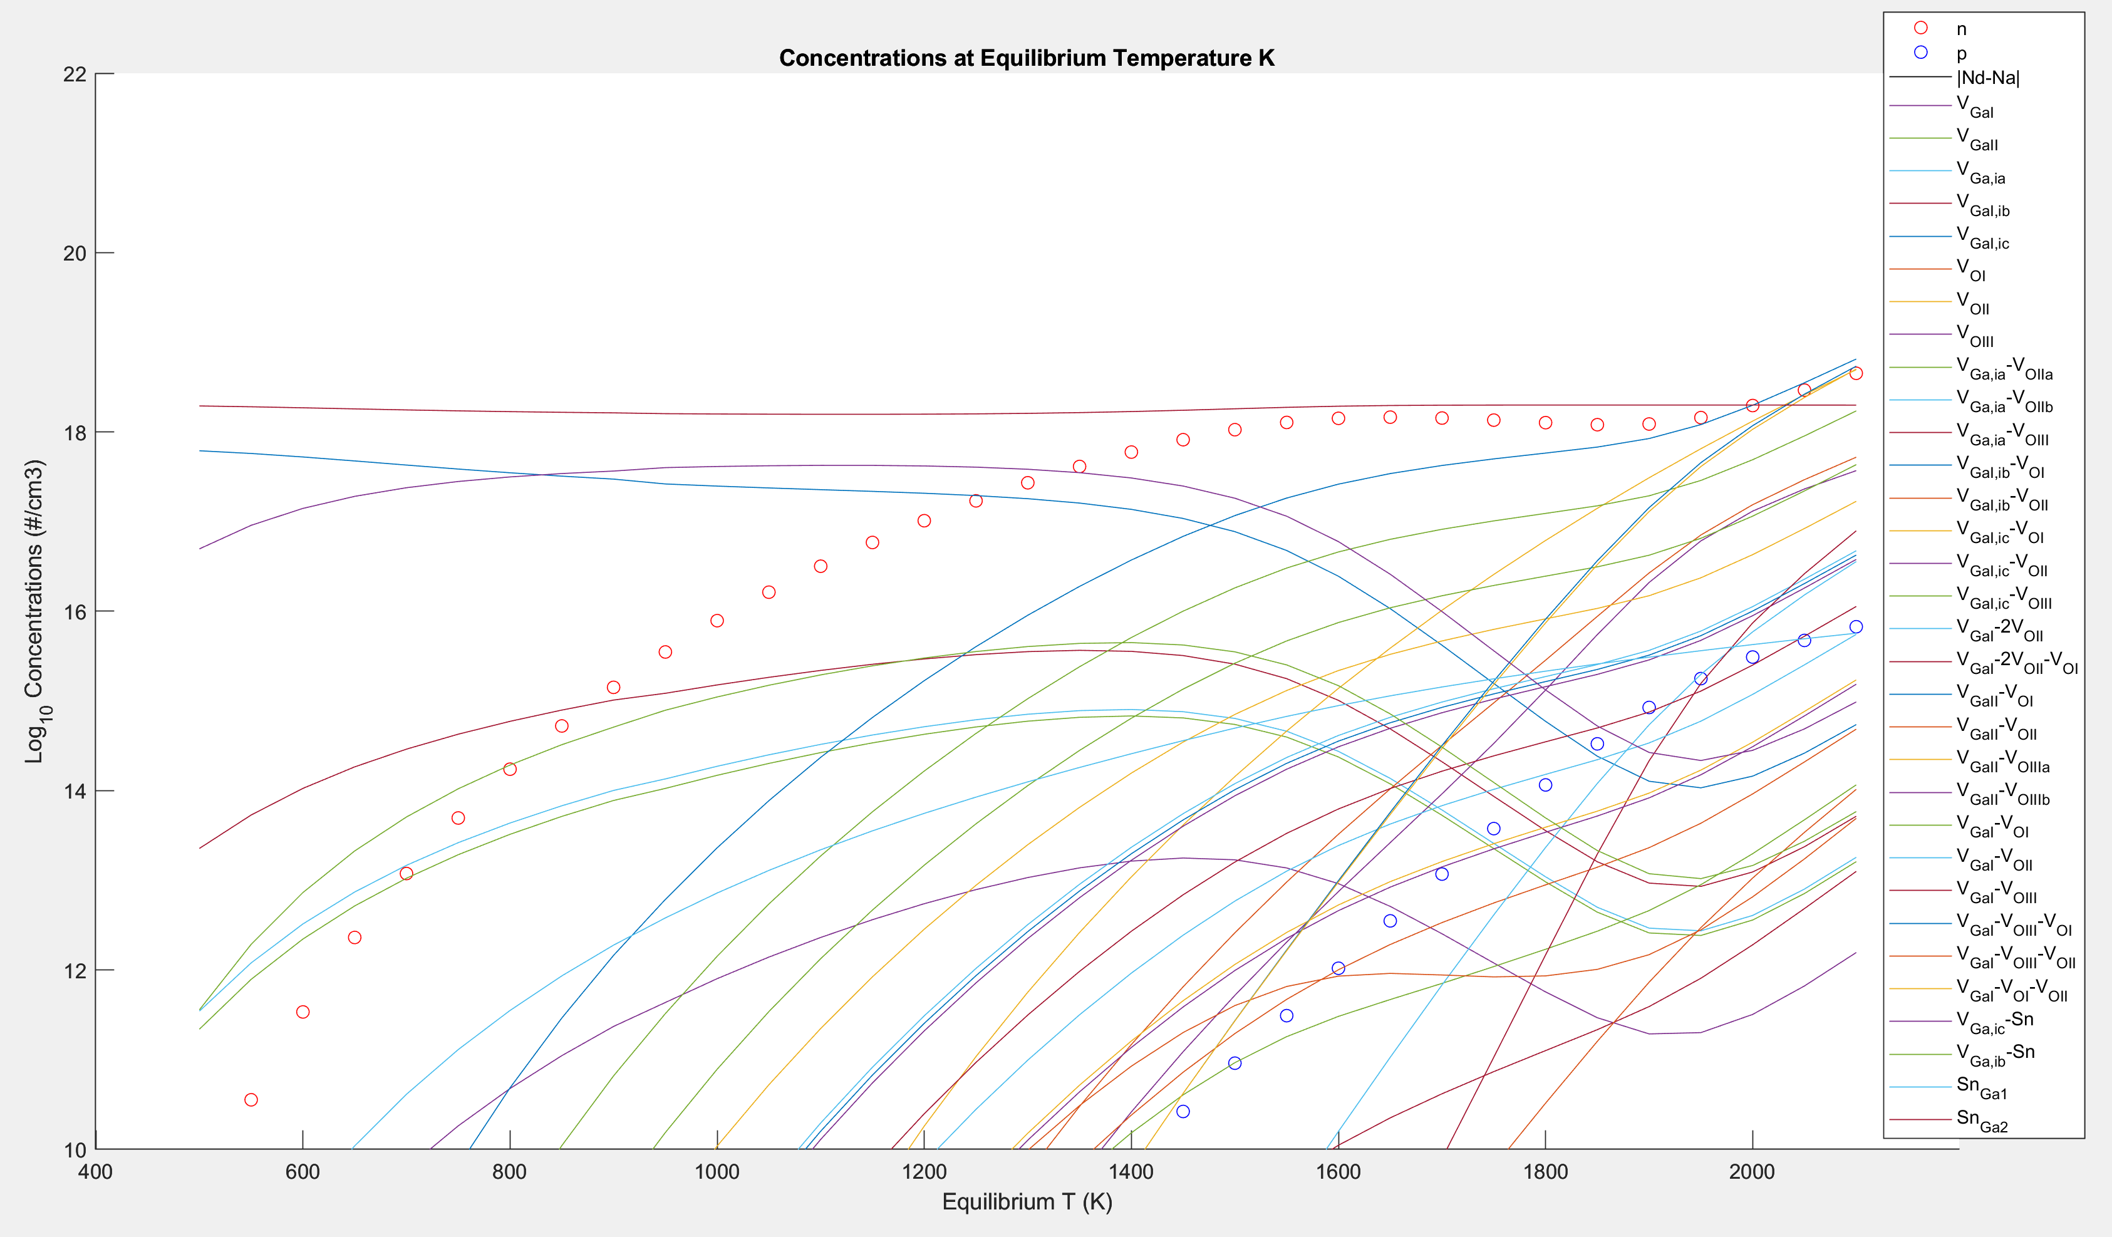
After 5 Minutes…Concentrations for 193 Defects
*Big thank you to Joel and Ymir here!

Slide 8
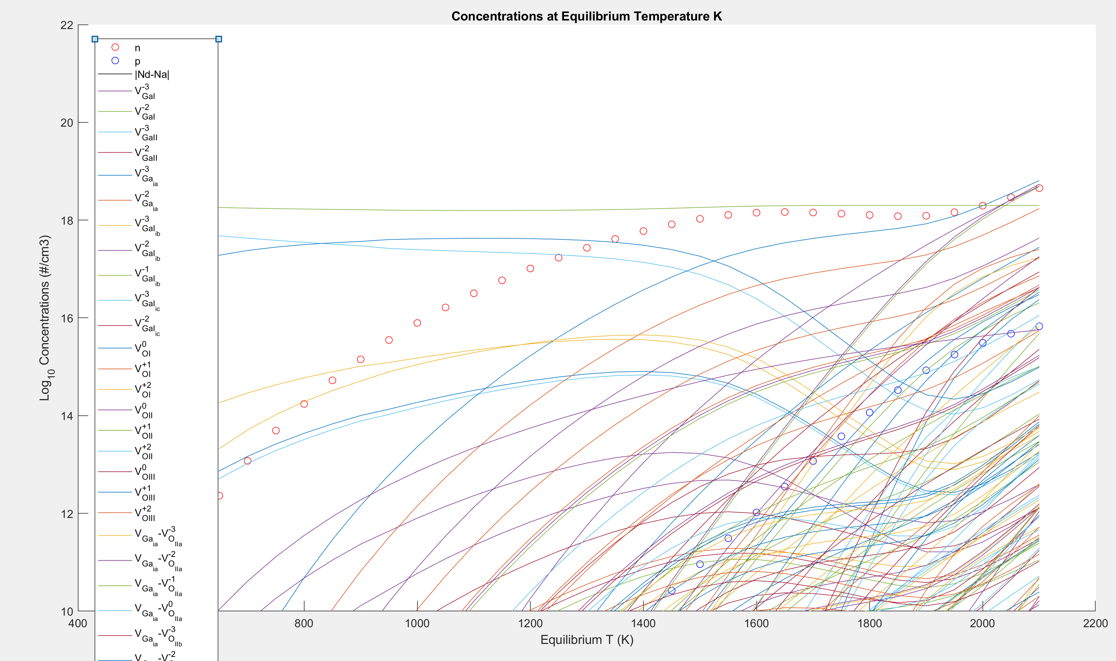
Concentrations for 622 Chargestates, e- and h+

Slide 9
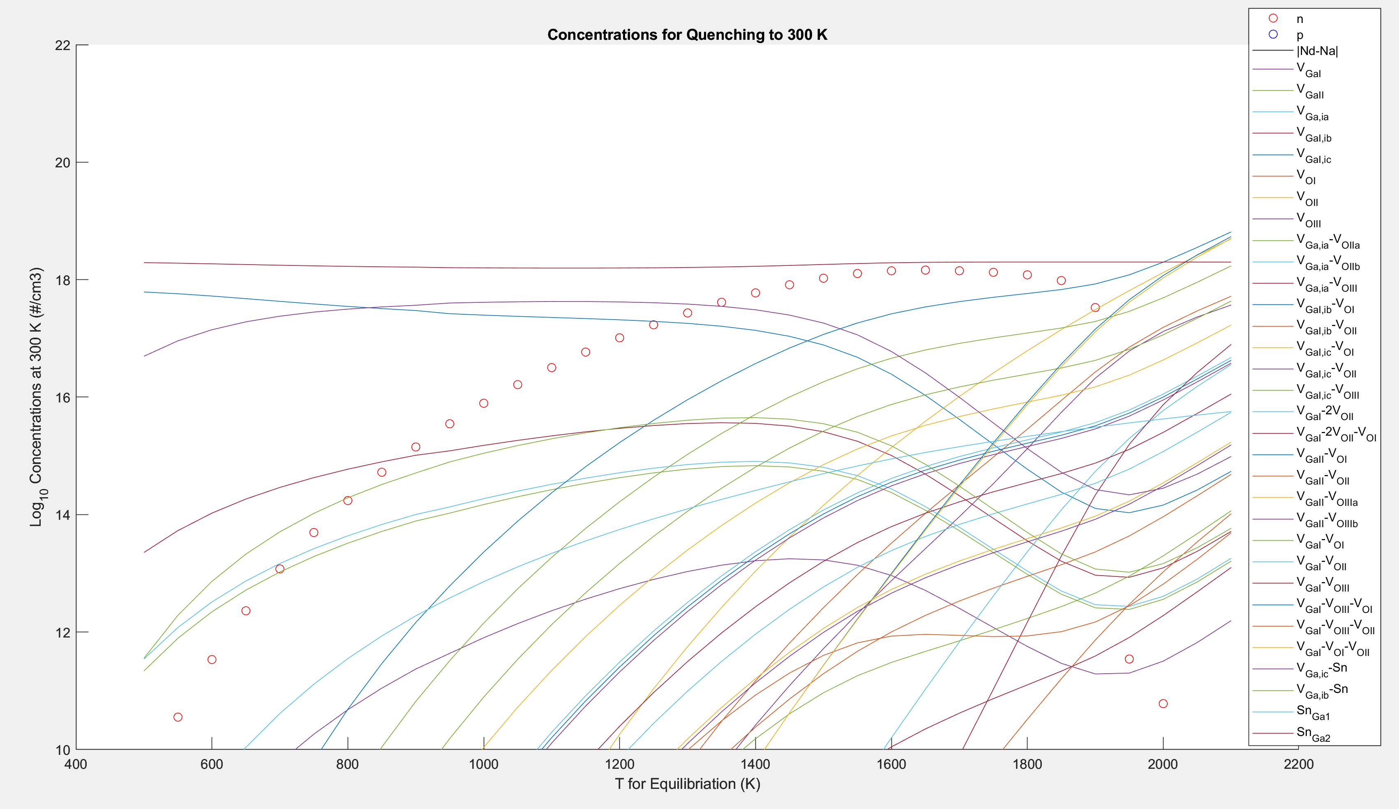
Defects and Electron Concentration after Quenching from Each T_{equilibrium}

Slide 10
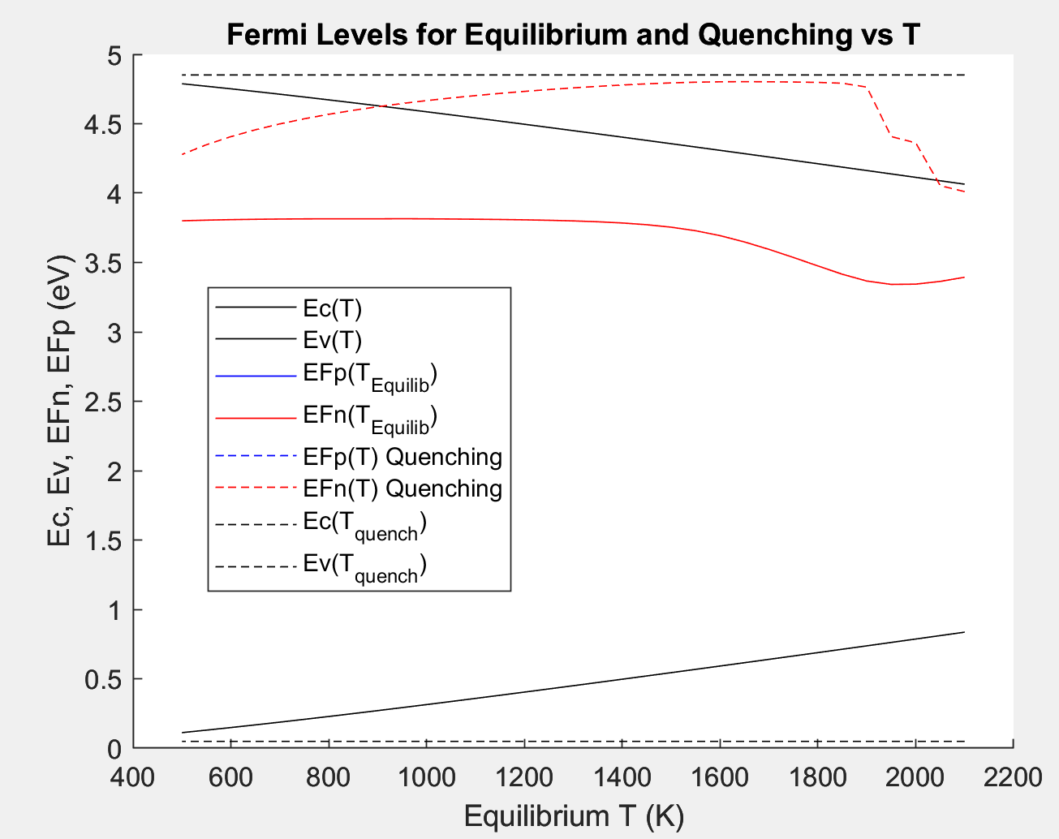
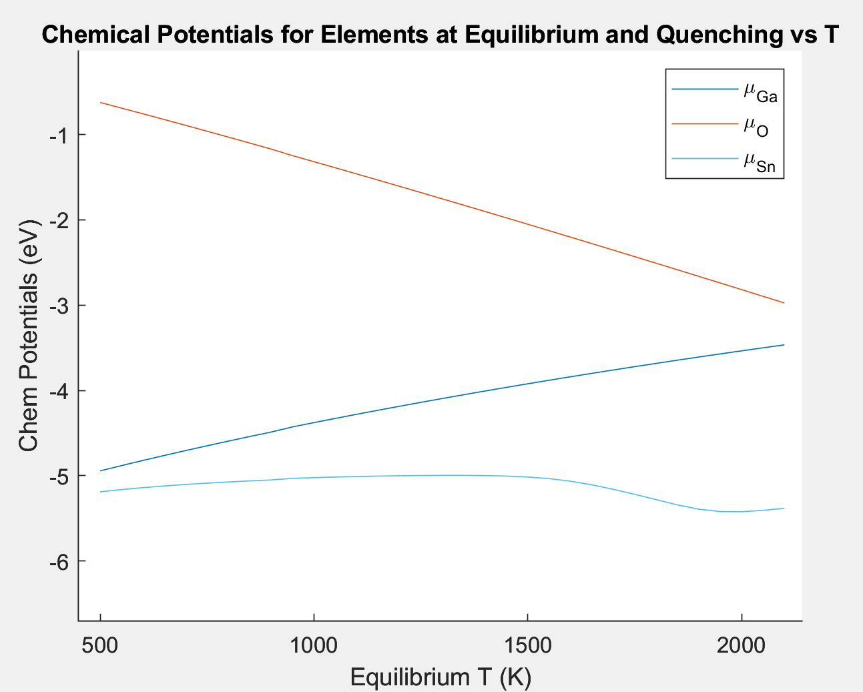
Fermi Levels on the Band Diagram and Chemical Potentials Making up the Solution vs T

Slide 11
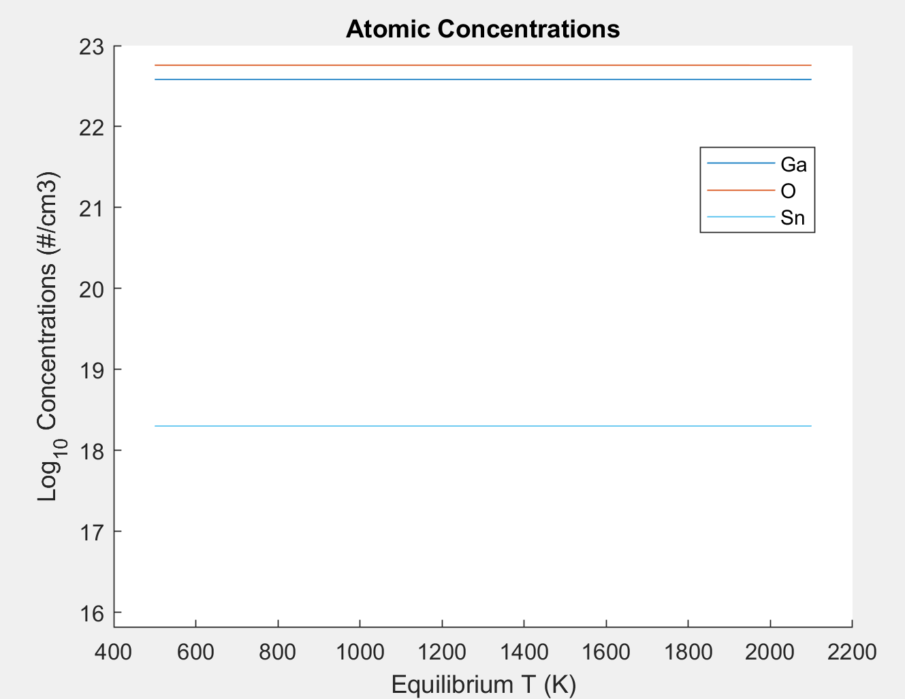
Net final atom concentrations
Shows that [Sn]=2e18 /cm3 was enforced at each T.
Ga and O concentrations vary at the 1e18/1e22 = 100 ppm level so can’t really see this on the plot..just like it’s neigh impossible to measure in real life until defects reach at%

Slide 12
Background & Defect Concentration Problem Structure
We are dealing with modelling. The predictive power of the model is only as good as the assumptions, model implementation, and inputs.
A philosophy behind developing Kroger is to move from bespoke models for specific cases that typically a-priori assume that only a few defects will matter and allowing inclusion of an arbitrary number of defects and letting the math sort out which ones dominate under what regimes.
Still, if a certain defect is not included in the set of those possible, the model will be incomplete. So the approach is only as good as the set of defects included.
Now, let’s examine the types of calculations Kroger can perform.

Slide 13
Defect Chargestates and Charge Transition Levels
Conduction Band
Ec
Defect in -2 chargestate
-/-2
-2
E_{F}
-1
Defect in -1 chargestate
+1
0/-
Formation Energy
Defect in 0 chargestate
0
+/0
0
Defect in +1chargestate
0
Valence Band
Fermi Energy
Thermodynamic Charge Transition Levels (CTLs) are the Fermi level positions at which the populations of two chargestates are equal. These are determined by the E_{F} values where their formation energies cross.

Slide 14
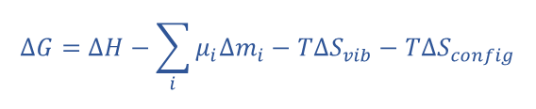
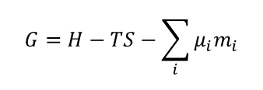
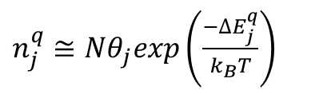

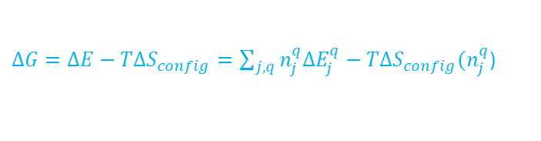
Formalism for Calculating Defect Concentrations
Express the change in free energy upon perturbing the crystal by forming defects randomly
Take partial derivatives with respect to defect numbers, holding some variables constant
Set partial derivatives = 0 and solve for the n_{j}^{q} ’s at equilibrium
$$G=H−TS−\sum_{i}{μ_{i}m_{i}}$$
Gibbs energy for crystal (0 = perfect)
Notation
n_{j}^{q}
chargestate
Chemical Potentials x Element Concentrations (including E_{F} for electrons)
#
defect / complex type
$$∆G=∆H−\sum_{i}{μ_{i}{∆m}_{i}}−T{∆S}_{vib}−T∆S_{config}$$
Energy change per defect
Collect into ΔE for all chargestates
$S_{config}=k_{B}ln\left(\frac{θ^{n} N!}{n!\left(N−n\right)!}\right)$
$∆G=∆E−T∆S_{config}=\sum_{j,q}{n_{j}^{q}{∆E}_{j}^{q}}−T{∆S}_{config}(n_{j}^{q}$)
Total for all defects
In dilute limit, this is linear in n_{j}^{q}
n = # defects
N= # total sites
θ = multiplicity/degeneracy factor
Nonlinear, but separable for dilute
ΔΕ for each chargestate
$n_{j}^{q}≅Nθ_{j}exp\left(\frac{−{∆E}_{j}^{q}}{k_{B}T}\right)$
Concentrations of each chargestate
in dilute limit
Eq. 1
Eq 1 can be considered exact to the extent that 1) Sterling’s approximation and 2) (N-n)≈N are accurate

Slide 15

Problem #1 – most basic defect calculation
Assumptions:
All defects or defect complexes are neutral (great assumption for metals and for ionic crystals)
All chemical potentials are known and held constant vs. T
The formation energies ΔE_{j} for all defects _{j}, are known e.g. from DFT calculations. This is equivalent to knowing the equilibrium constants for quasichemical single-defect formation reactions.
All defects / complexes remain in the dilute limit such that N_{sites}>>n_{j}, and N_{sites}>sum(n_{j}). This makes the S_{config} separable / independent for each defect.
Task: Calculate numbers of all defects at different temperatures
$n_{j}^{q}≅Nexp\left(\frac{−{∆E}_{j}^{q}}{k_{B}T}\right)$
We have one equation per defect, so this is just plugging in the ΔE, into

Slide 16
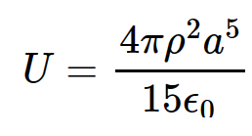
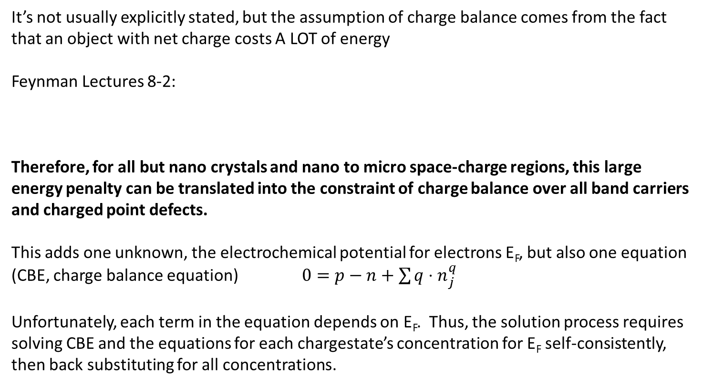
Complication Added by Charged Defects
It’s not usually explicitly stated, but the assumption of charge balance comes from the fact that an object with net charge costs A LOT of energy
Feynman Lectures 8-2:
Therefore, for all but nano crystals and nano to micro space-charge regions, this large energy penalty can be translated into the constraint of charge balance over all band carriers and charged point defects.
This adds one unknown, the electrochemical potential for electrons E_{F}, but also one equation (CBE, charge balance equation) $0=p−n+\sum{{q⋅n}_{j}^{q}}$
Unfortunately, each term in the equation depends on E_{F}. Thus, the solution process requires solving CBE and the equations for each chargestate’s concentration for E_{F} self-consistently, then back substituting for all concentrations.
U = total electrostatic energy
ρ = charge density
a = sphere radius
ε_{o}= dielectric constant

Slide 17
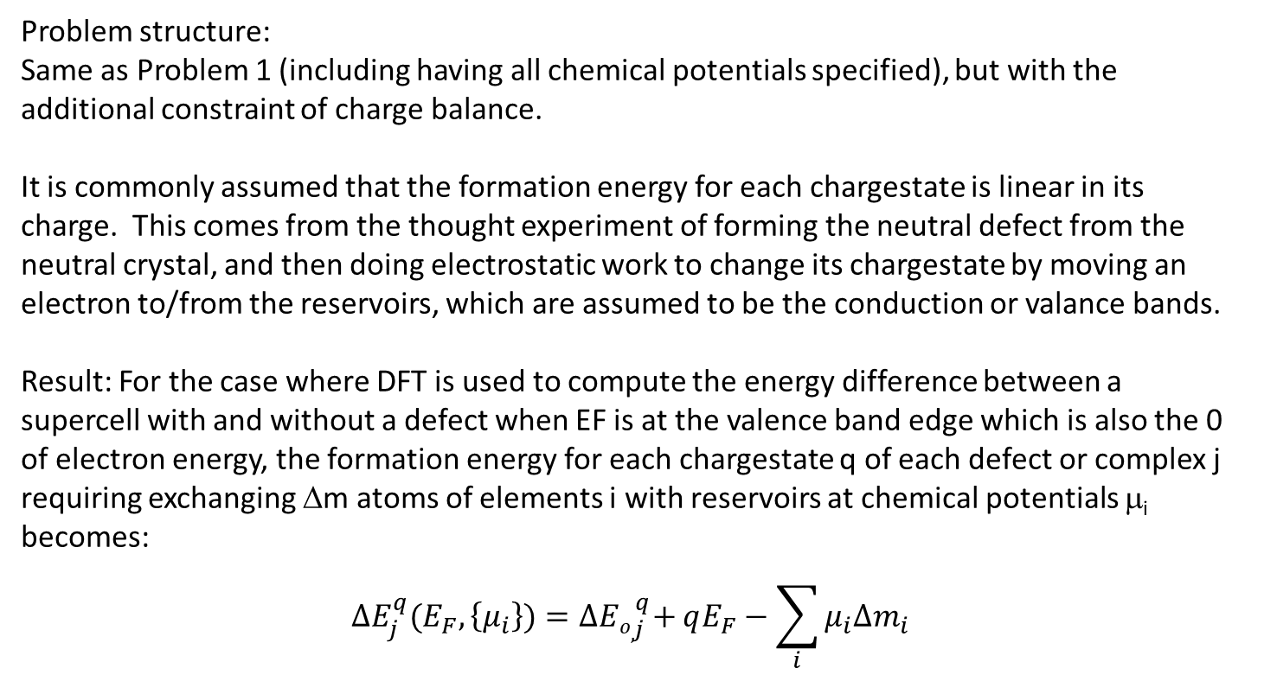
Problem #2: Charged Defects in Full Equilibrium
Problem structure:
Same as Problem 1 (including having all chemical potentials specified), but with the additional constraint of charge balance.
It is commonly assumed that the formation energy for each chargestate is linear in its charge. This comes from the thought experiment of forming the neutral defect from the neutral crystal, and then doing electrostatic work to change its chargestate by moving an electron to/from the reservoirs, which are assumed to be the conduction or valance bands.
Result: For the case where DFT is used to compute the energy difference between a supercell with and without a defect when EF is at the valence band edge which is also the 0 of electron energy, the formation energy for each chargestate q of each defect or complex j requiring exchanging Δm atoms of elements i with reservoirs at chemical potentials μ_{i} becomes:
$$ΔE_{j}^{q}(E_{F},\left\{μ_{i}\right\})=Δ{Eo,}_{j}^{q}+qE_{F}−\sum_{i}{μ_{i}Δm_{i}}$$
We note that Problem 1 considering only neutral defects is a special case of Problem 2 with all q’s =0. It’s just easier to introduce things this way.

Slide 18
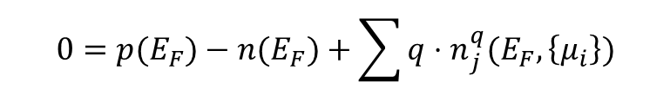
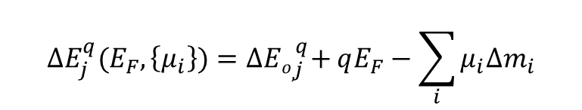
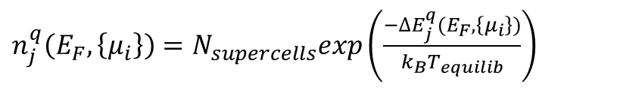
Problem #2 Continued
All the μ’s are given. T_{equilib} is given. The # sites, primitive cells, or supercells/volume is given*. We must solve the system of equations below for E_{F} and the n_{j}^{q}’s.
$$ΔE_{j}^{q}(E_{F},\left\{μ_{i}\right\})=Δ{Eo,}_{j}^{q}+qE_{F}−\sum_{i}{μ_{i}Δm_{i}}$$
$n_{j}^{q}\left(E_{F},\left\{μ_{i}\right\}\right)=N_{supercells}exp\left(\frac{−{∆E}_{j}^{q}(E_{F},\left\{μ_{i}\right\})}{k_{B}T_{equilib}}\right)$
$$0=p(E_{F})−n(E_{F})+\sum{{q⋅n}_{j}^{q}(E_{F},\left\{μ_{i}\right\})}$$
Solving involves finding the Ef producing a root for the CBE, then back-substituting.
*Note on N_{sites} or N_{supercells}: This will be in #/cm³. For complexes or defects with large lattice relaxations, calculations should be done using an appropriately large volume for N. For example, the primitive unit cell by definition contains on formula unit and one of each unique atom of the basis on the lattice site. A complex may require two of the same atom on two adjacent lattice sites; thus the whole calculation must be done on the basis of a supercell consisting of 2 primitive cells. Larger ones can be used but then correction for the geometric multiplicity of this complex within the supercell must be made.

Slide 19
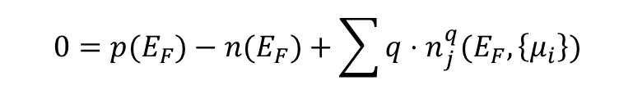
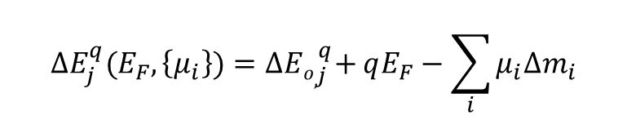
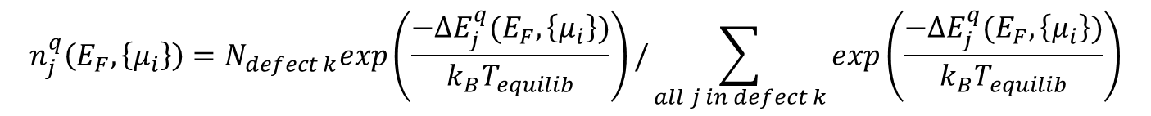
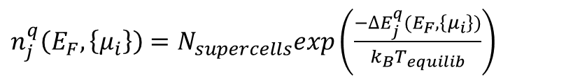
Problem #3: Hold the concentrations of some defects or chargestates constant.
Fixed chargestates n_{j}^{q} are quite simple: the charge associated with a certain chargestate can be entered as a constant into the CBE. This just replaces its n_{j}^{q} equation with a constant.
Fixed defects are slightly more complicated, but not too much. The relative fractions of the chargestates of the defect are computed from a partition function based on their formation energies and trial values of E_{F} to enforce the total specified for the defect.
$$ΔE_{j}^{q}(E_{F},\left\{μ_{i}\right\})=Δ{Eo,}_{j}^{q}+qE_{F}−\sum_{i}{μ_{i}Δm_{i}}$$
$$n_{j}^{q}\left(E_{F},\left\{μ_{i}\right\}\right)=N_{defect k}exp\left(\frac{−{∆E}_{j}^{q}(E_{F},\left\{μ_{i}\right\})}{k_{B}T_{equilib}}\right)/\sum_{all j in defect k}{exp\left(\frac{−{∆E}_{j}^{q}(E_{F},\left\{μ_{i}\right\})}{k_{B}T_{equilib}}\right)}$$
$n_{j}^{q}\left(E_{F},\left\{μ_{i}\right\}\right)=N_{supercells}exp\left(\frac{−{∆E}_{j}^{q}(E_{F},\left\{μ_{i}\right\})}{k_{B}T_{equilib}}\right)$
For all other j’s
$$0=p(E_{F})−n(E_{F})+\sum{{q⋅n}_{j}^{q}(E_{F},\left\{μ_{i}\right\})}$$

Slide 20
Problem #4: Calculate the defects and carriers present after quenching from an equilibrium temperature to another T
Quenching calculations usually assume that all of the defect concentrations are fixed at the high temperature, but the electrons can rearrange to vary the fractions of chargestates making up each defect. It’s essentially assuming that atomic diffusion is suppressed but that electronic degrees of freedom remain able to respond to the new temperature.
This is straightforward once problem 3 is mastered. The equilibrium calculation is done as previously. Then, the total concentration for each defect type is summed over its chargestates. Then, partition functions are built for each defect individually and the chargestates reapportioned at the new temperature.
Full quenching is described above. It is also possible to implement partial quenching; perhaps most of the defects are frozen in at one temperature but at the new temperature, a few can still equilibrate by exchanging atoms (think fast diffusers like interstitials). So cases of partial equilibrium can be constructed once the tools for full quenching are developed.

Slide 21
Problem #5: Some Elements Fixed
This problem becomes more complicated because it means that the CBE as well as now one additional equation for each element must be solved implicitly and simultaneously for Ef plus that element’s chemical potential mu.
Sometimes this is formulated in terms of Lagrange multipliers, but the result is the same. Partial differentiation of the composite potential functional (free energy plus constraints times Lagrange multipliers) and setting each to 0 recovers the same equations to be solved. Prof. Anil Virkar at UUtah has published many excellent papers using the Lagrange approach for specific cases.
The approach implemented in Kroger as of now is to build a composite objective function:
func (Ef, {fixed mu’s}) = abs(total charge)+abs([elmt1]-target1)+abs ([elmt2]-target2)+…
and then using optimization solvers to drive this objective to zero. The concentrations of each element are easily computed from the numbers of each defect containing that element.
Ways of improving performance are still being tried, but Kroger was deemed ready for first release once it could successfully complete problems of types 1-5 and mixtures thereof.
As of now, Kroger first performs a very fine (less than kBT spacing along each variable) exhaustive grid search over a domain specified by the user. This ensures that the true solution will not be missed, but it can take some serious time. Because of the exp() functions involved, the objective function tends to be flat over large regions, with sharp canyons punctuated by a deep but narrow minimum around the solution. This makes finding it with downhill optimizers challenging unless a really good initial guess is supplied – hence the exhaustive grid search first. But to make the runtime reasonable (number of points scales as n^dim where dim is 1 for Ef plus the number of fixed elements), the user should bracket the solution by running partial solutions first and then letting the optimizer refine the precision of the solution. So far, no substitute for actually understanding the problem you’re trying to solve has been hard coded in…

Slide 22
Why Constraints on Concentrations are Difficult
The example of charge balance illustrates a general feature of calculating defect concentrations with specified conditions. Each term in the Gibbs, Helmholtz, … free energy (besides the internal energy U) is the product of an intensive potential and its conjugate extensive quantity – e.g. chemical potential * # atoms of each element
Each equation of constraint on numbers of defects or groups of defects results in the need to solve implicitly, simultaneously for an additional conjugate potential.
For example, if we want to specify the total P concentration in Si, we must solve simultaneously for E_{F} and the μ_{P} that satisfy the CBE and make the sum of all the P atoms in all the various defects and complexes equal the target concentration.
The permuted couplings between {chemical potentials, EF} depend on concentrations and the set of defects and complexes in the problem. Sometimes the variables might be nearly independent, but it’s possible for Ef to change strongly with one or more mu’s if that element is involved in the dominant dopant defect. Also, when two elements form defects that play a similar role in the charge balance equation solving may become difficult in practice. Decisions about the solution approach differentiate how effective Kroger and programs like it will be in specific cases.

Slide 23
Implementing Temperature Dependencies
Kroger’s main calculation routine was built to loop internally over a list of temperatures and calculate at each one in the list.
This includes the ability to include temperature dependent material properties, defect properties, and thermodynamic conditions into a set of calculations. For example the positions of the band edges relative to the charge transition levels of the defects were varied in the example calculation shown in the first few slides. As were the chemical potentials for O and Ga. Both of these actually make significant differences in even basic predictions.
For example, melt-grown Sn-doped Ga2O3 wafers bought commercially and grown in fixed p_{O2} are quite n-type conductive, but first-order defect calculations predict that such wafers should be insulating. The temperature-dependent movement of the conduction band edge and to some extent the changing O destabilizes V_{Ga} and V_{Ga}-Sn_{Ga} complexes (both acceptors) at high temperatures. Otherwise, the charge balance would call for numbers of these defects equal to the number of Sn such that E_{f} goes near mid-gap.
Kroger was designed from the beginning to be able to do such things, so we look forward to implementing more dependencies such as T dependence of the formation energies of charge states (and thus charge transition levels), exact rather than estimated vibrational entropies.
Also, concentration-dependent formation energies are possible once defects begin to overlap – exploring the transition from dilute to alloy concentrations is another long-term interest.

Slide 24
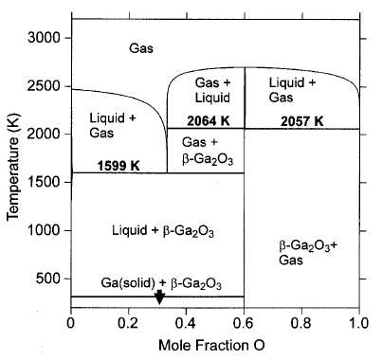
Example of Temperature & pO₂ Dependency of Chemical Potential
Calculated from thermochemical functions (Gº(T,P) for each phase or mixture) used for the Ga-O binary phase diagram
Clearly, holding O and Ga chemical potentials constant would yield very different predictions.
Besides the Ga and O end-members, equilibrium with other thermodynamic conditions such as fixed pressure of suboxide Ga₂O + O, etc can be implemented. Even defects formed during Ga2O3 growth or etching may be possible problem specifications.
Zinkevich, Matvei & Aldinger, Fritz. (2004). Thermodynamic Assessment of the Gallium‐Oxygen System. Journal of the American Ceramic Society.

Slide 25
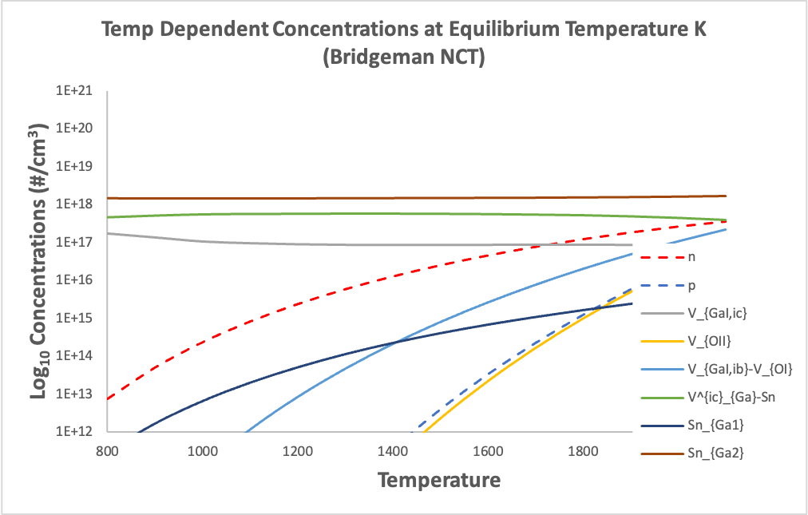
Effects of T, P dependent Chemical Potentials
Constant µ calculation
Temperature Dependent Calculation
Constant µ_{O}, µ_{Ga} predicts totally wrong electron concentration
µ(T) needed for agreement with reality
pO₂ = 20% of P, holding constant Sn concentration

Slide 26
Some Other Neat Things Kroger can do
The main calculation engine takes in two data structures: one defining the material and conditions and the other defining the set of defects to include. It outputs the numbers of each defect for those inputs. It has been written to loop internally over a list of equilibration temperatures.
The main engine was designed such that subsets of chargestates, defects, or elements may be held constant and the remaining ones calculated according to chemical potentials and charge balance (which actually means floating the potentials for the fixed quantities and implicitly solving for them ;). Thus many interesting and advanced uses can be constructed using this versatile tool.
This is done by entering one or more temperatures and calling the engine within an external loop. For example, a Brouwer diagram at one temperature can be made by looping over a list of pO2’s and creating output tables and plots. We have also done things like sweeping over shallow doping Nd, or sweeping the chemical potential or number of one impurity element (this helps a user bracket solutions when multiple elements are to be held constant simultaneously).
We are excited to try solving new problems using Kroger! Collaborations are invited!

Slide 27
Comments and Thoughts
As of now, Kroger exists in Matlab but we may try pythonization soon. Stay tuned.
As of now Kroger consists of pretty well-developed internal subroutines but a specific problem is run via a long script with a few hundred lines of code to look over in order to define the problem structure to be solved. We are thinking about building a GUI but for now let’s collaborate and find some new insights.
Other packages we have seen for defect calculations seem to be set up somewhat differently; basically automating or augmenting the DFT workflow to do the energetics calculations, and then doing some of Kroger’s functions afterwards. Not doing DFT ourselves (to date) we decided to focus on making the very best possible calculations of defect concentrations and leave the DFT part for others.
For now, contact Prof. Scarpulla to set up things to try. We are looking forward to collaborating on new materials. The whole point was to build something generally useful across any material and any sets of interesting defects, to move away from everyone needing to build bespoke models for each case.
What is needed at a minimum to start something new is a list of defects defined by their atoms exchanged, sites used, and chargestates and their raw formation energies (without any chemical potential effects; so the energy of formation when Ef=Ev=0).
We’re really excited to branch into other materials and to include further physical effects. Kroger could be incorporated into other programs that compute spatial-dependencies of defects… the list goes on.
We believe Kroger is at least as sophisticated as any other package out there, at least the ones we have read about, and we have a passion for this kind of calculation that allows translating from DFT energies to actual, particular samples grown by different methods (CZ, FZ, MBE, MOCVD, etc)

Slide 28
Kroger Origin Story
For Mike Scarpulla, the kernel for writing something like Kroger began around 2010 when Shiyou Chen and Suhuai Wei (then at NREL) used hybrid functionals to compute fairly accurate charge transition levels and bandgap for CZTS [1]. Prior, it was anyone’s guess how accurate formation energies and charge transition levels were using lesser functionals. Now the game was afoot: since the formation energies were now getting close to experiments, it was worth spending time applying all the various corrections to the defect calculation itself.
Volodymyr Kosyak joined Mike at Utah as a postdoc and together they modeled defects in CZTS under a specific experimental condition (isothermal annealing in presence of excess sulfur). This introduced the concept of how different calculations could end up being if chemical potentials, partial pressures, or something like equilibrium vapor pressure over another phase were kept fixed. Also in that paper [2] relations between overall composition (rather than chemical potentials) and numbers of defects were calculated. Work from Scott Dunham on defects in CZTS based on composition rather than chemical potentials [3] illustrated for Mike how such calculations could be done.
Mike became obsessed with the fact that DFT phonon calculations were becoming computationally possible, thus allowing the effects of vibrational entropy to be assessed. Andrei Postnikov had computed Raman spectra for CZTS and agreed to try computing changes in phonon density of states induced by a handful of plentiful defects. Probably the supercells were too small in that particular paper [2] so effect magnitudes may have been overestimated. However, the fact that temperature-dependent physical effects could reorder the predicted dominant defects – truly change the qualitative prediction as well as quantitative - sparked for Mike a longer-term interest in taking into account all the nitty-gritty effects in calculations of defect concentrations. Such a thing should be general, not specific for one material, and written to handle general sets of possible defects not just specific ones guessed at the beginning to be important.
Fundamental funding from AFOSR on defects in Ga₂O₃ gave Mike the opportunity to spend time on what would be a long-term endeavor. During the pandemic, Elif Ertekin and Joel Varley were kind and patient enough to spend hours talking through every step of DFT based defect energetics calculations and the various temperature-dependent effects. Many discussions helped to figure out how to merge free energies for phases with defect concentration numbers. It took approximately 3 years of on and off work combined with studying papers describing other related codes both old and new to implement all of the advanced features contained in the code.
The program’s name was chosen to honor Kroger’s nearly exhaustive (>900 pages) treatment of defect equilibrium across many different scenarios [4].
Of course these cited works are not the only works on this vast subject that has formed the basis of entire careers for many very talented people. These are simply landmarks in the intellectual journey for this particular program by its authors.
[1] https://doi.org/10.1103/PhysRevB.81.245204, [2] https://doi.org/10.1063/1.4819206, [3] https://doi.org/10.1109/JPHOTOV.2015.2430015, [4] F.A. Kroger, “The Chemistry of Imperfect Solids”, 2nd Edition. North-Holland (1974)

Slide 29
Thanks for Reading! Let’s Calculate!

Slide 30
Glossary I
Lattice: An infinite set of points in space arranged with discrete translational symmetry
Atomic Basis: An arrangement of atoms placed on each lattice point to make a crystal
Crystal: Atoms arranged on a lattice and thus also having the symmetries of the lattice
Unit cell: the lattice or crystal can be generated by copying the unit cell, translating it by a lattice vector, and pasting it. This describes tessellating space with the unit cell.
Primitive Unit Cell: The smallest unit cell having minimum volume. It encloses exactly one lattice point and one formula unit of the crystal.
Supercell: A unit cell consisting of multiple primitive cells. These are used in DFT calculations with plane-wave basis sets and periodic boundary conditions to reduce the influence of self-interactions between defects. The question is always whether or not the supercell used was large enough to suppress wavefunction overlap, strain coupling, local phonon mode coupling, electrostatic coupling…
Flaw: any disturbance of the perfect crystal. These could be host atoms out of place or impurities. Synonymous with defect.
Defect: point defects, defect complexes, defect clusters, precipitates, dislocations, twin boundaries, antiphase boundaries, grain boundaries, interfaces, surfaces, voids…

Slide 31
Glossary II
Point Defect: One or a few atoms out of place or extra. Usually listed as 0 dimensional, but no defect is truly 0D – even isotopic disorder in Si produces some tiny non-uniform strains. Usage herein will usually mean one elementary or irreducible missing host atom or impurity. Examples are vacancies, substitutional impurities, and interstitials.
Relative charge: If a Fe²⁺ ion is sitting where a Ga³⁺ should be, the relative charge within the ionic limit is -1. If P with 5 valence electrons substitutes for a Si atom having 4 valence electrons in a crystal of Si, the bonding is mostly covalent but still there is one extra proton, which is balanced out by the localization of one electron (the orbital can be large, but still it is bound). The P_{Si} (phosphorous substituting for Si) defect would be in it’s q=0 charge state when the electron is localized to that P atom, and ionized into its q=1 state when the electron is thermally excited into the conduction band.
Charge state: One defect in one configuration may be able to localize a varying number of electrons such that its net charge relative to the same site in the perfect crystal may vary from -4 to +4. High chargestates of 3 or 4 are rather rare. At that point there is enough electrostatic incentive to form a complex and reduce the total charge (a form of screening).

Slide 32
Glossary III
Point Defect Complex: Two or more elementary point defects in a bound grouping, usually but not always via electrostatic attraction (think strain and electronegativity as next strongest interactions). Formally, the defects can be anywhere from a dimer of two atoms squeezed onto into the same site as in an F-center in alkali halides to a Schottky pair (cation and anion vacancy pair) separated by many lattice constants. Practically, once the binding energy is comparable to k_{B}T, the complex can be considered dissociated back into isolated defects – meaning that they are no longer bound and can diffuse apart from each other to arbitrary distance. This makes the definition of a complex somewhat squishy…this is really analogous to excitons between band charge carriers.
Cluster: Too big to be a complex but too small to be a new phase.
Configuration: A point defect or complex may have a ground state as well as multiple metastable configurations of the atoms. These may or may not involve changes of chargestate. F-centers in alkalai halides were first examples. In semiconductors, DX and AX centers are more frequently discussed.
Vacancy: a missing host atom. Ex: a missing Ga atom in β-Ga₂O₃ on the Ga_{I} site of the atomic basis in one primitive unit cell creates one V_{GaI}
Interstitial Site: Each crystal has some spots between the atoms
Impurity: an atom not of the host. Can be substitutional on a host atom site, or interstitial meaning squeezed into the space between some host atoms

